Slide 1



BOOKSTORE MANAGEMENT SYSTEM

Slide 2
Team and Roles
Keshoju Bhargavi
Dhandre Rakshitha
Prince Vijay Santhosh
Potla Bhavana
Malyala Suchitha
:
:
:
:
:
Code
Code
PPT/Code
PPT
PPT

Slide 3
About Project
Book distributors record handling is one of the complex process and it required computerized system to maintain overall transactions in an easier manner.
Due to heavy demand of books in these competitive worlds, data increase so much. Books shop required up to date information about the customer who purchased books or about the suppliers from where books are purchased.
The books shop requires large amount of data to record and to store, which are collected from the Book House.

Slide 4
About Project
A Bookstore Management System is a python application that helps manage the daily operations of a bookstore. The application can handle tasks such as tracking book inventory, Add Books, Sell Books, Display Books.
The system can have features such as adding, editing and deleting books, managing information and more.
It is linked with SQLite 3 Data base to store the records.

Slide 5
About Project
It provides various facilities for the retail book shop to maintain records of the books and also search, display, modification, delete etc the books available. This software searches the books data which is store in the record.
The software used for small shops for maintaining their records related to books selling, printing the reports and cost savings.

Slide 6
Key Takeaways from Project Brief
Purpose: Revolutionize the way bookstores operate by creating a cutting-edge python application to streamline daily operations.
Features and Tech: The Bookstore Management System will offer comprehensive solutions, including the ability to effortlessly add, edit, and delete books, all while covering concepts of Python programming language and effectively managing data through the database systems.
Requirements: To ensure seamless and efficient management, the system will prioritize proper data management practices.

Slide 7
User Stories
As a Bookstore Manager, I want to be able to add new books to the inventory, so I can keep track of the latest arrivals and offerings.
As a Bookstore Manager, I want to be able to edit book information, so I can keep the inventory up-to-date.
As a Bookstore Manager, I want to be able to delete books from the inventory, so I can manage the stock effectively.
As a Customer, I want to be able to search for books, so I can easily find what I am looking for.
As a Customer, I want to have a user-friendly experience when using the Bookstore Management System, so I can easily find and purchase the books I want.

Slide 8
User Tasks(In order after prioritizing)
Add new books to the inventory
Delete books from the inventory
Search for books
Edit book information
Ensure a user-friendly experience

Slide 9
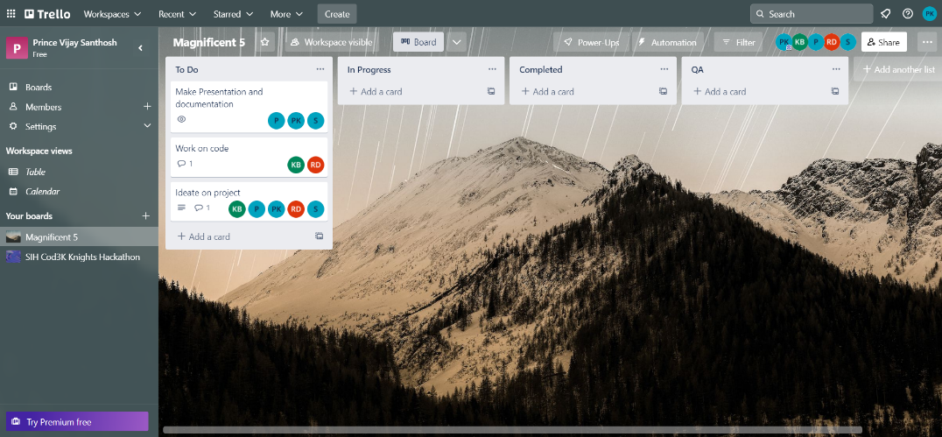
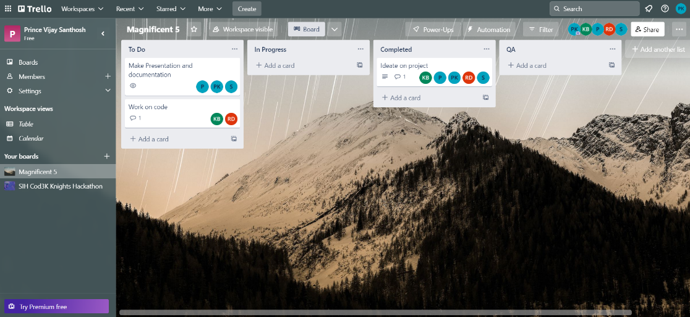
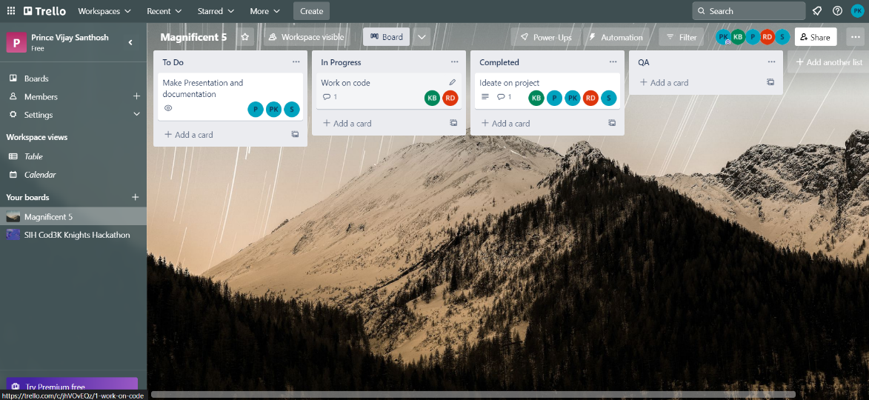
Trello(Scrum Master)

Slide 10
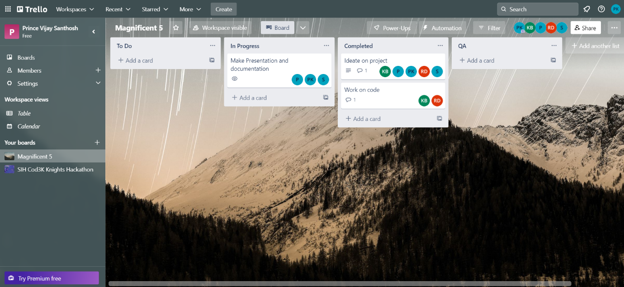
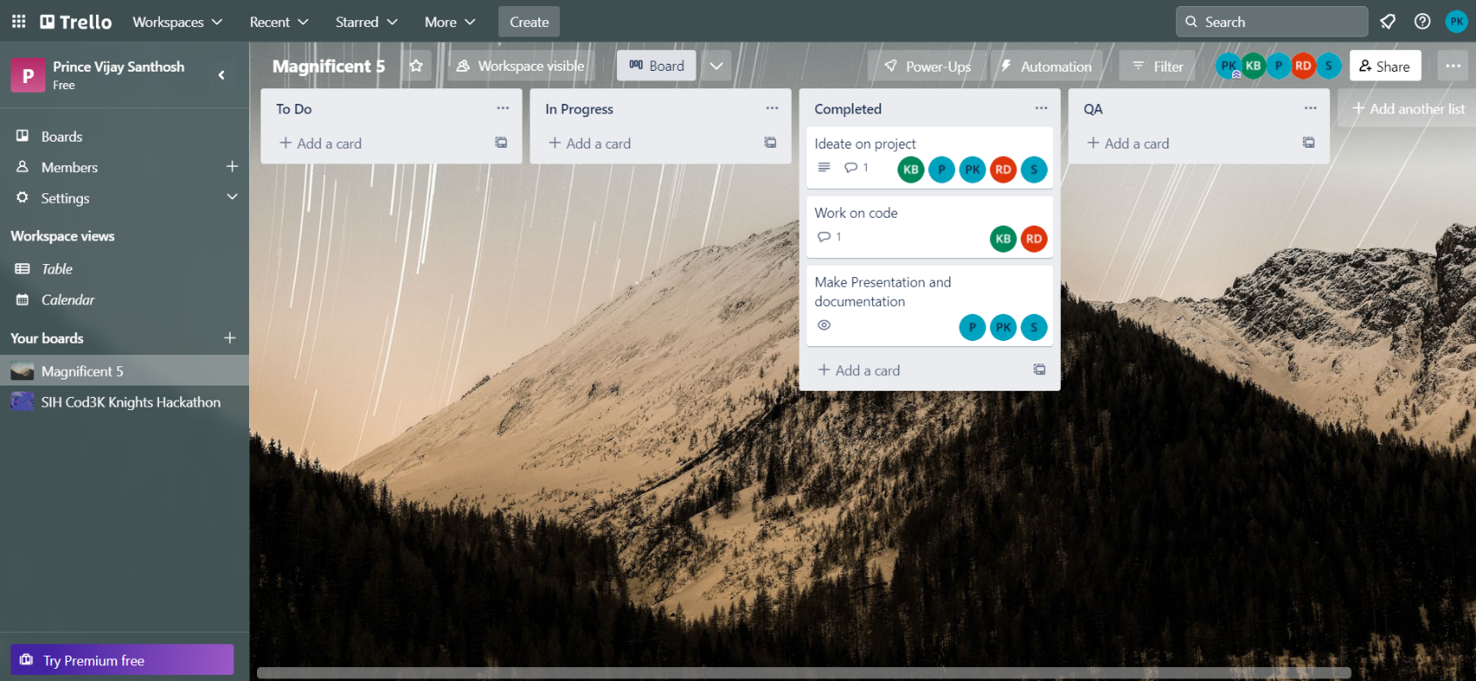
Trello(Scrum Master)

Slide 11
Implementation
LISTS AND TUPLES: In a Bookstore Management System, Lists and Tuples can be used to store and manage the data of books available in the store. Lists are mutable, i.e., they can be changed dynamically while tuples are immutable, i.e., they cannot be changed once created. Lists can be used to store book details like book name, author, ISBN number, and price, while tuples can be used to store the details of a single book.
CONDITIONS: If, Else: The 'If-Else' statement can be used to implement decision making in the Bookstore Management System. For example, if the user wants to add a book, the system can check if the ISBN number of the book is already present in the database. If it is present, the system can display a message "Book already present" else the book details can be added to the database.
SWITCH CASES AND BREAK: Switch cases can be used to implement multiple conditions in the Bookstore Management System. For example, the system can have different cases for different operations like add a book, delete a book, update a book, etc. The 'break' statement can be used to break out of the switch case statement once the desired operation is performed.

Slide 12
Implementation
FUNCTIONS: Functions can be used to perform repetitive tasks in the Bookstore Management System. For example, the 'Add Book' function can be used to add a book to the database and the 'Delete Book' function can be used to delete a book from the database. This helps in organizing the code and making it more readable.
PYTHON MODULES AND PACKAGES: Python modules and packages can be used to extend the functionality of the Bookstore Management System. For example, the 'sqlite3' module can be used to connect to the SQLite database and perform various database operations.
DATA BASE - SQLITE 3: SQLite 3 can be used as the database for the Bookstore Management System. The 'sqlite3' module can be used to connect to the SQLite database and perform various operations like adding a book, deleting a book, updating a book, etc. The database can store the book details like book name, author, ISBN number, and price, which can be used to manage the books in the store.

Slide 13
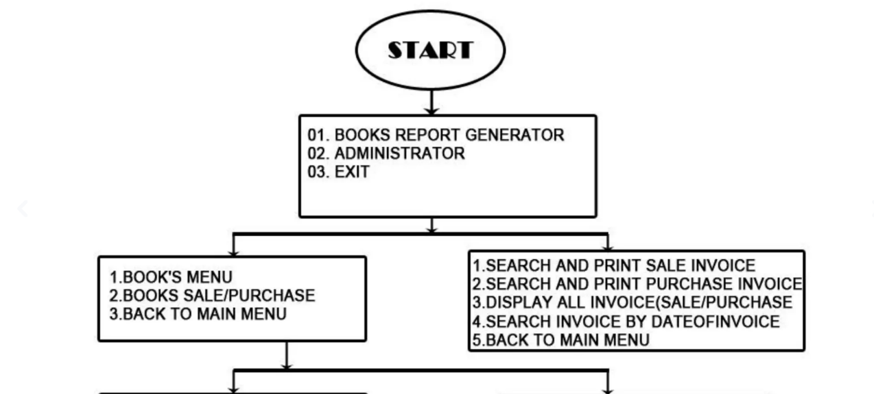
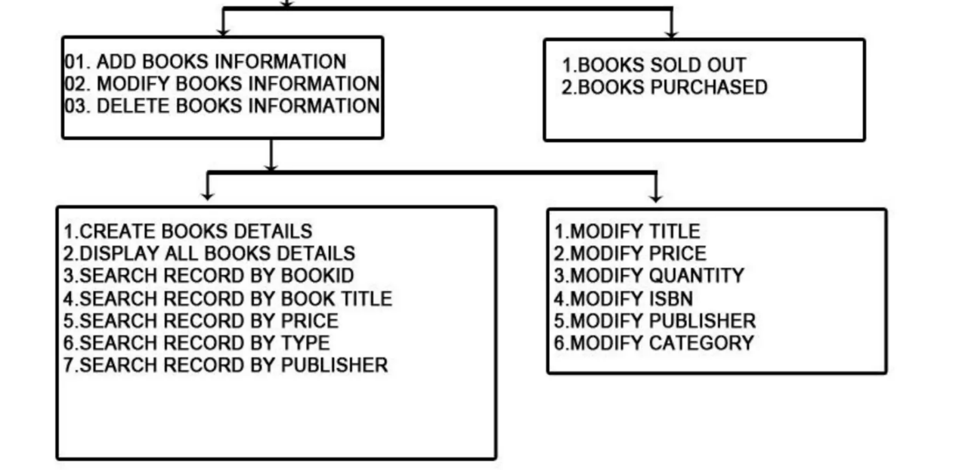
Implementation

Slide 14
Testing
ADD BOOKS: This functionality in the Bookstore Management System allows the user to add new books to the system's database. The user will input the book details such as the book name, author, ISBN, and price, etc. The system will store these details in its database for future reference.
SELL BOOKS: This functionality enables the user to sell books from the bookstore's stock. The user will input the book name, and the system will check if it is available in the database. If available, the system will update the stock count and generate a receipt for the customer.
DISPLAY BOOKS: This functionality provides the user with the ability to view the books available in the bookstore's stock. The user can choose to view all the books or filter the books based on certain criteria such as the author, publisher, or genre, etc.
EXIT: This functionality allows the user to exit the Bookstore Management System. The system will save any changes made during the session and close the program. This is useful for scenarios where the user wants to close the system without losing any data.

Slide 15
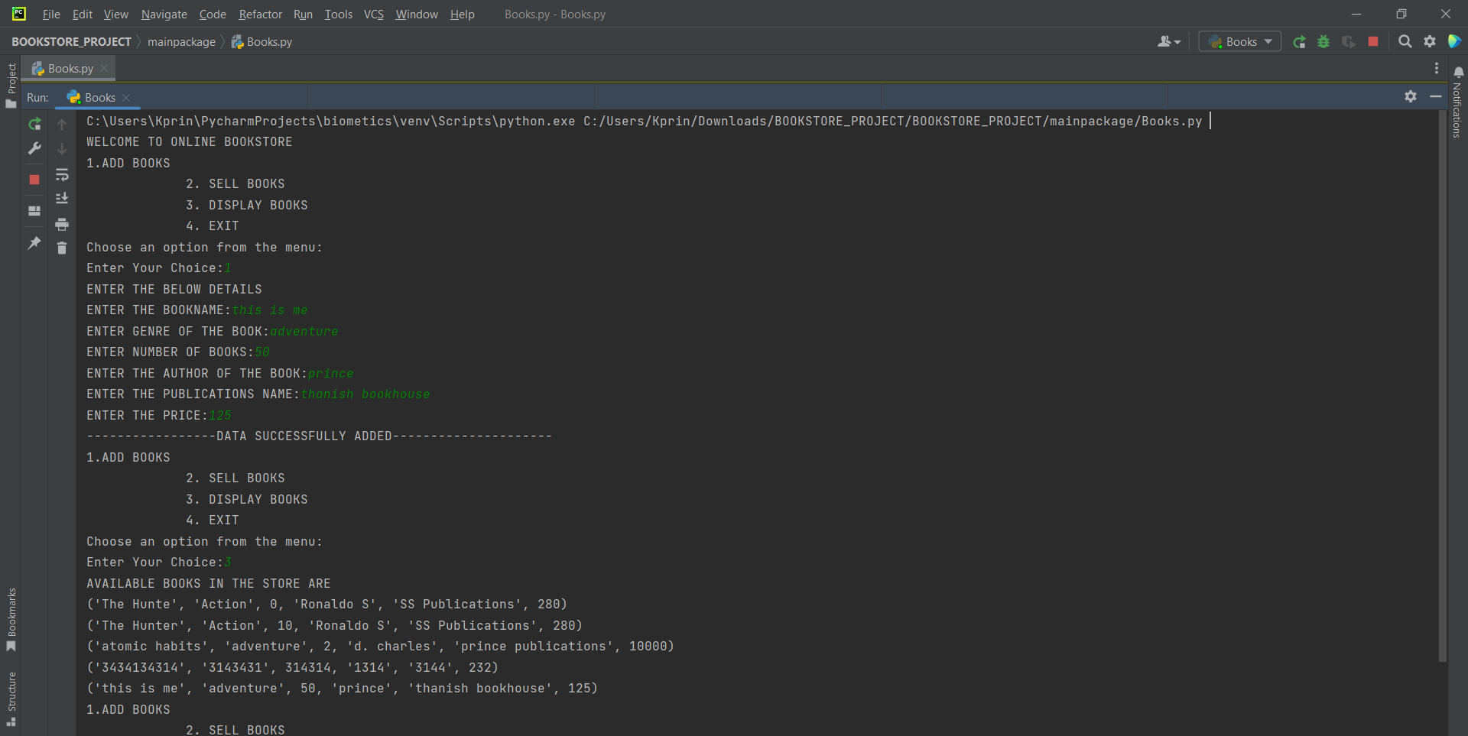
Project Demo

Slide 16
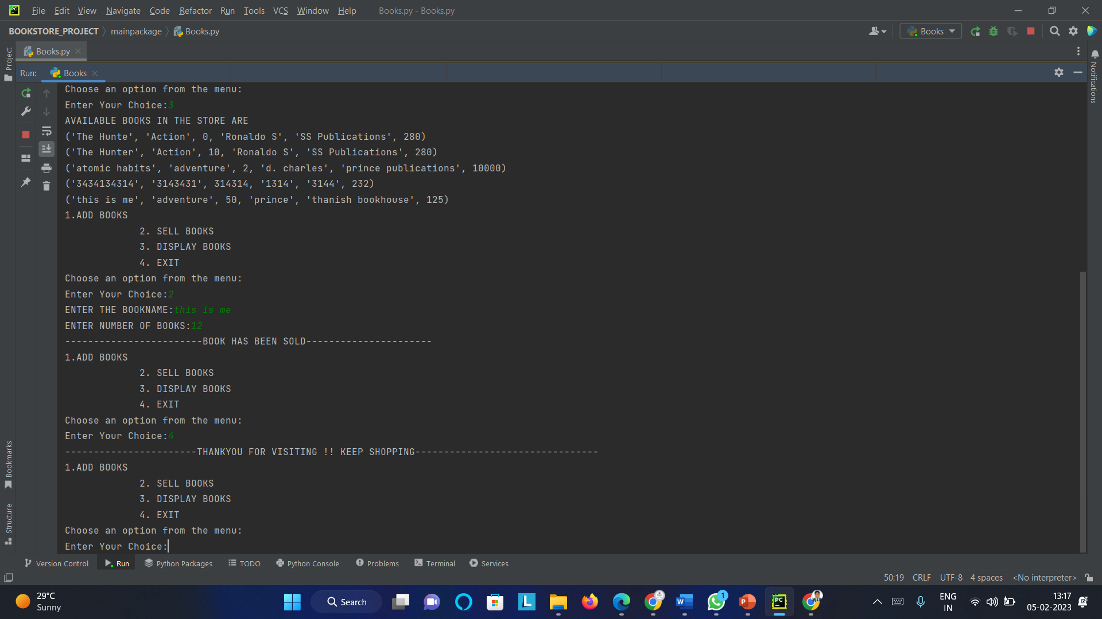
Project Demo

Slide 17
Retrospective Meet
What went well:
Accomplishments were achieved
Effective teamwork and collaboration among team members
Smooth project management processes
Adherence to project timelines
What didn't go well:
Missed deadlines for meet
Technical difficulties faced during the project
Issues with little communication gap

Slide 18
Retrospective Meet
What can be improved:
Processes for managing timelines.
Communication and collaboration strategies for team members.
Ways to address technical difficulties more efficiently

Slide 19
Thank you

